Slide 1
CRF-I Units: some change some didn’t.
05/07/18

Slide 2
Table of CRF-I Unit Changes
NEW CRF UNIT COUNTS:
CRF-I: n=27 to n=6
CRF-P: n=0 to n=22

Slide 3
Tables of CRF-E & CRF-PE Unit Changes
NEW CRF UNIT COUNTS:
CRF-I: n=27 to n=6
CRF-NR: n=32 to n=31
CRF-E: n=3 to n=6
CRF-PE: n=3 to n=0 (CRF-E now)

Slide 4
Tables of CRF-NR Unit Changes
NEW CRF UNIT COUNTS:
CRF-I: n=27 to n=6
CRF-E: n=3 to n=6
CRF-PE: n=3 to n=0 (CRF-E now)
CRF-P: n=0 to n=22
CRF-NR: n=32 to n=31

Slide 5
CRF-I units that changed to CRF-P

Slide 6
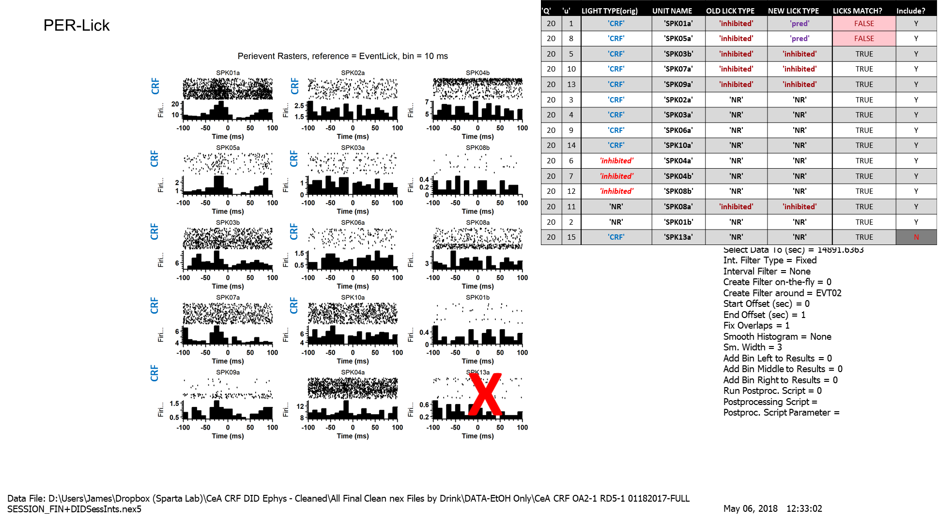
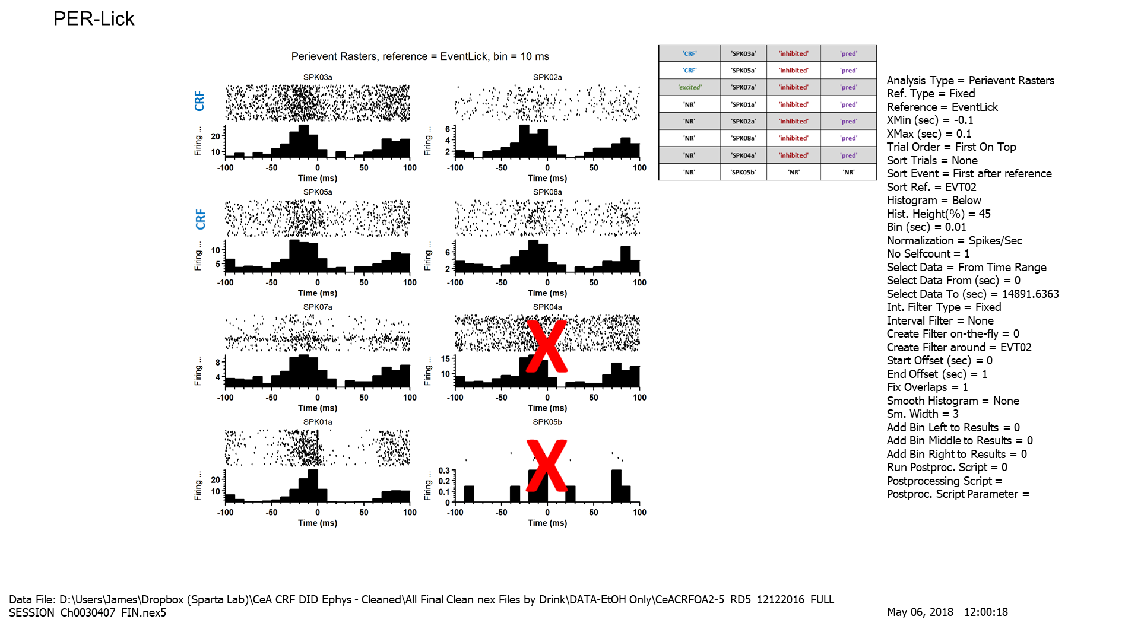
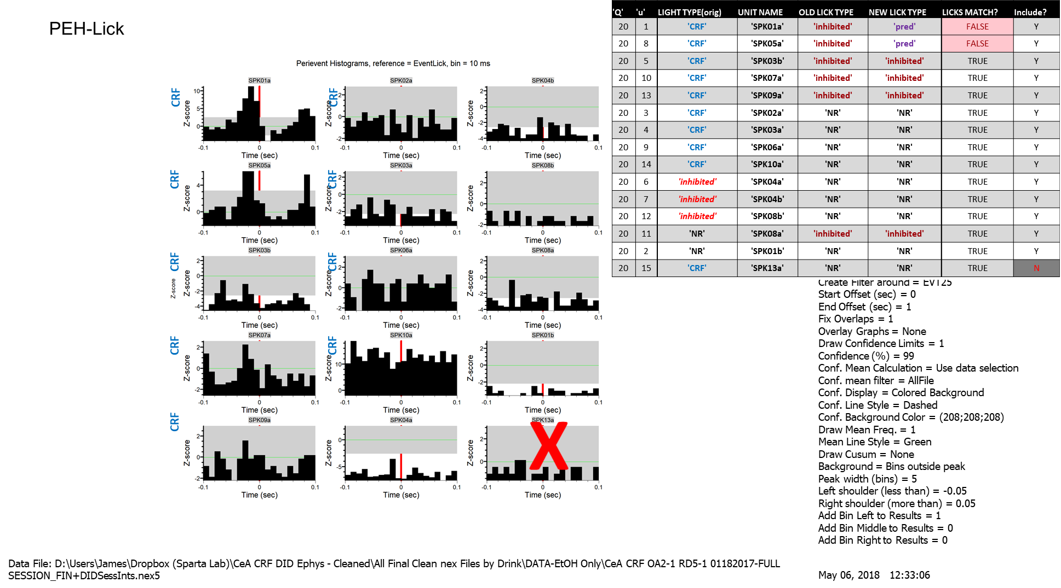
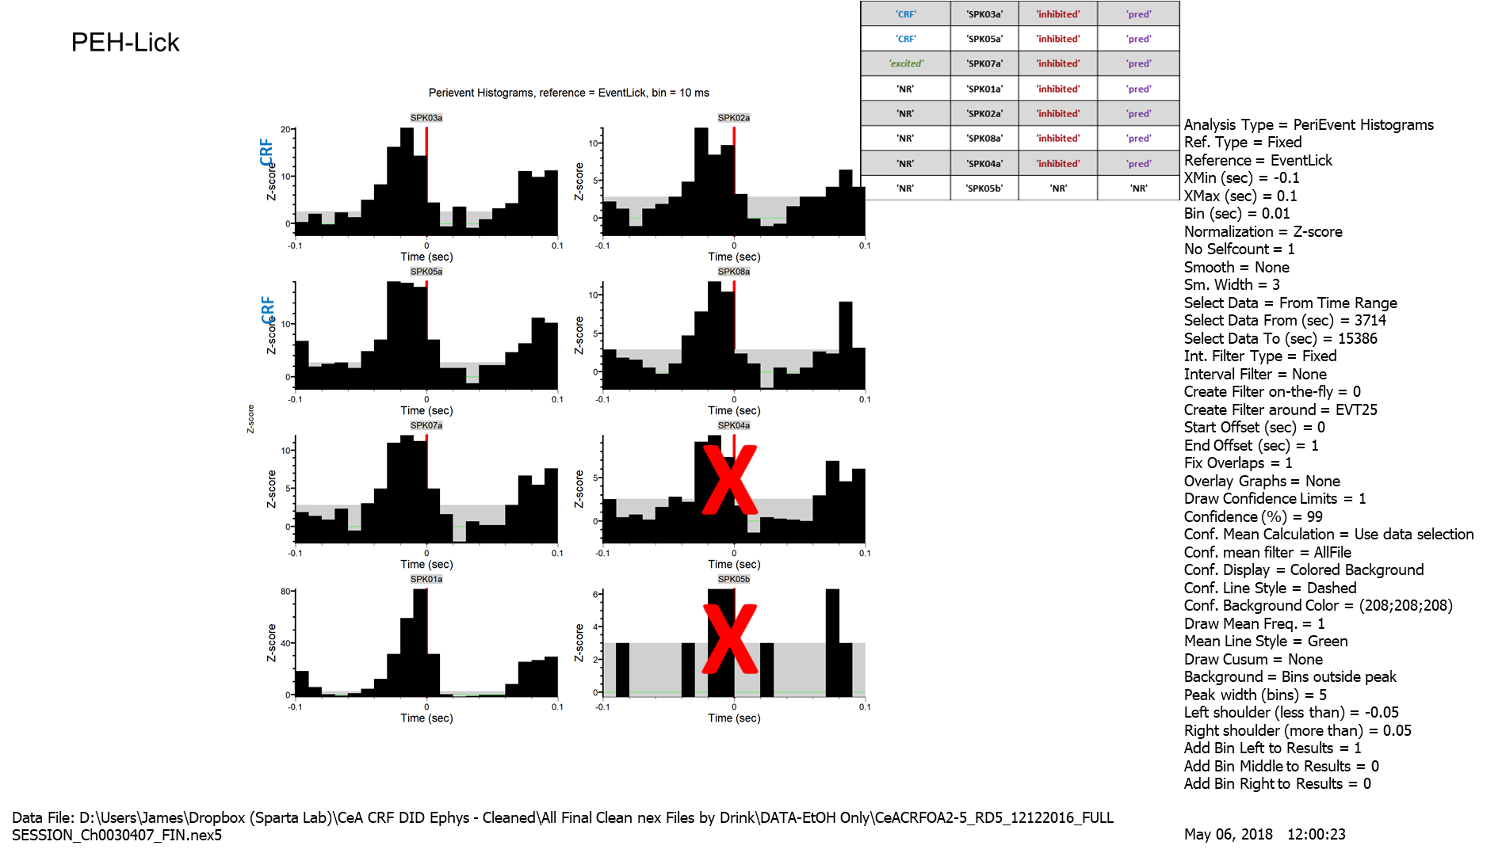
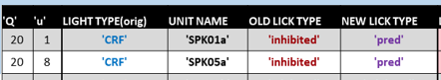
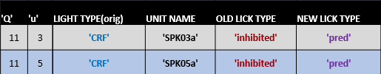
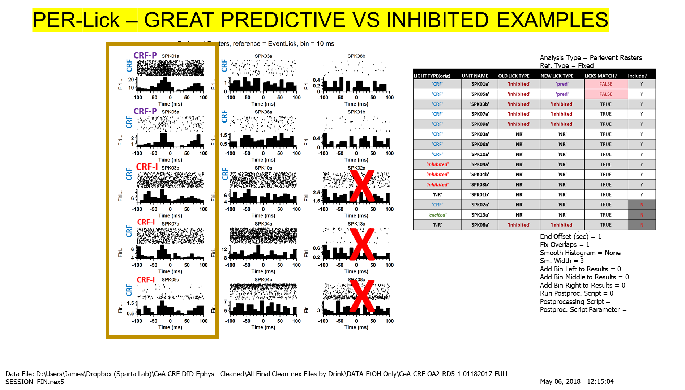
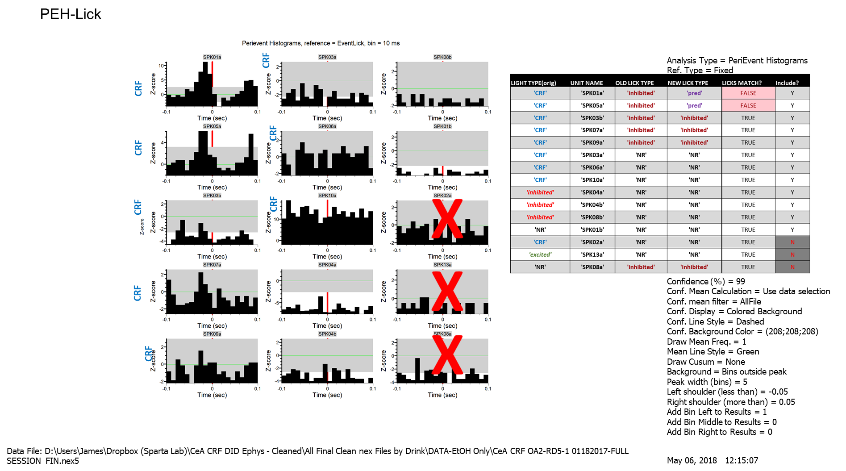
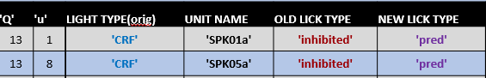
CRF-I that became CRF-P, Pt1

Slide 7
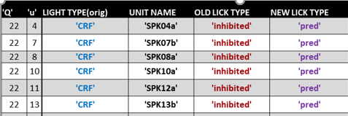
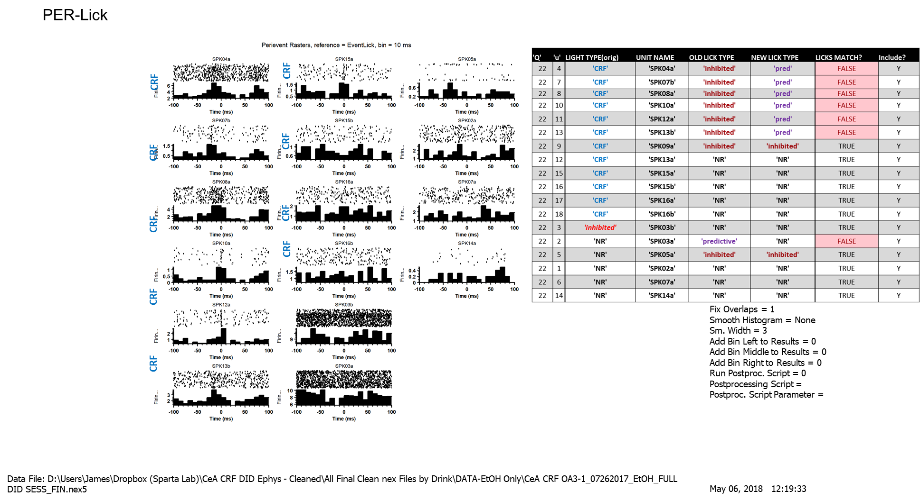
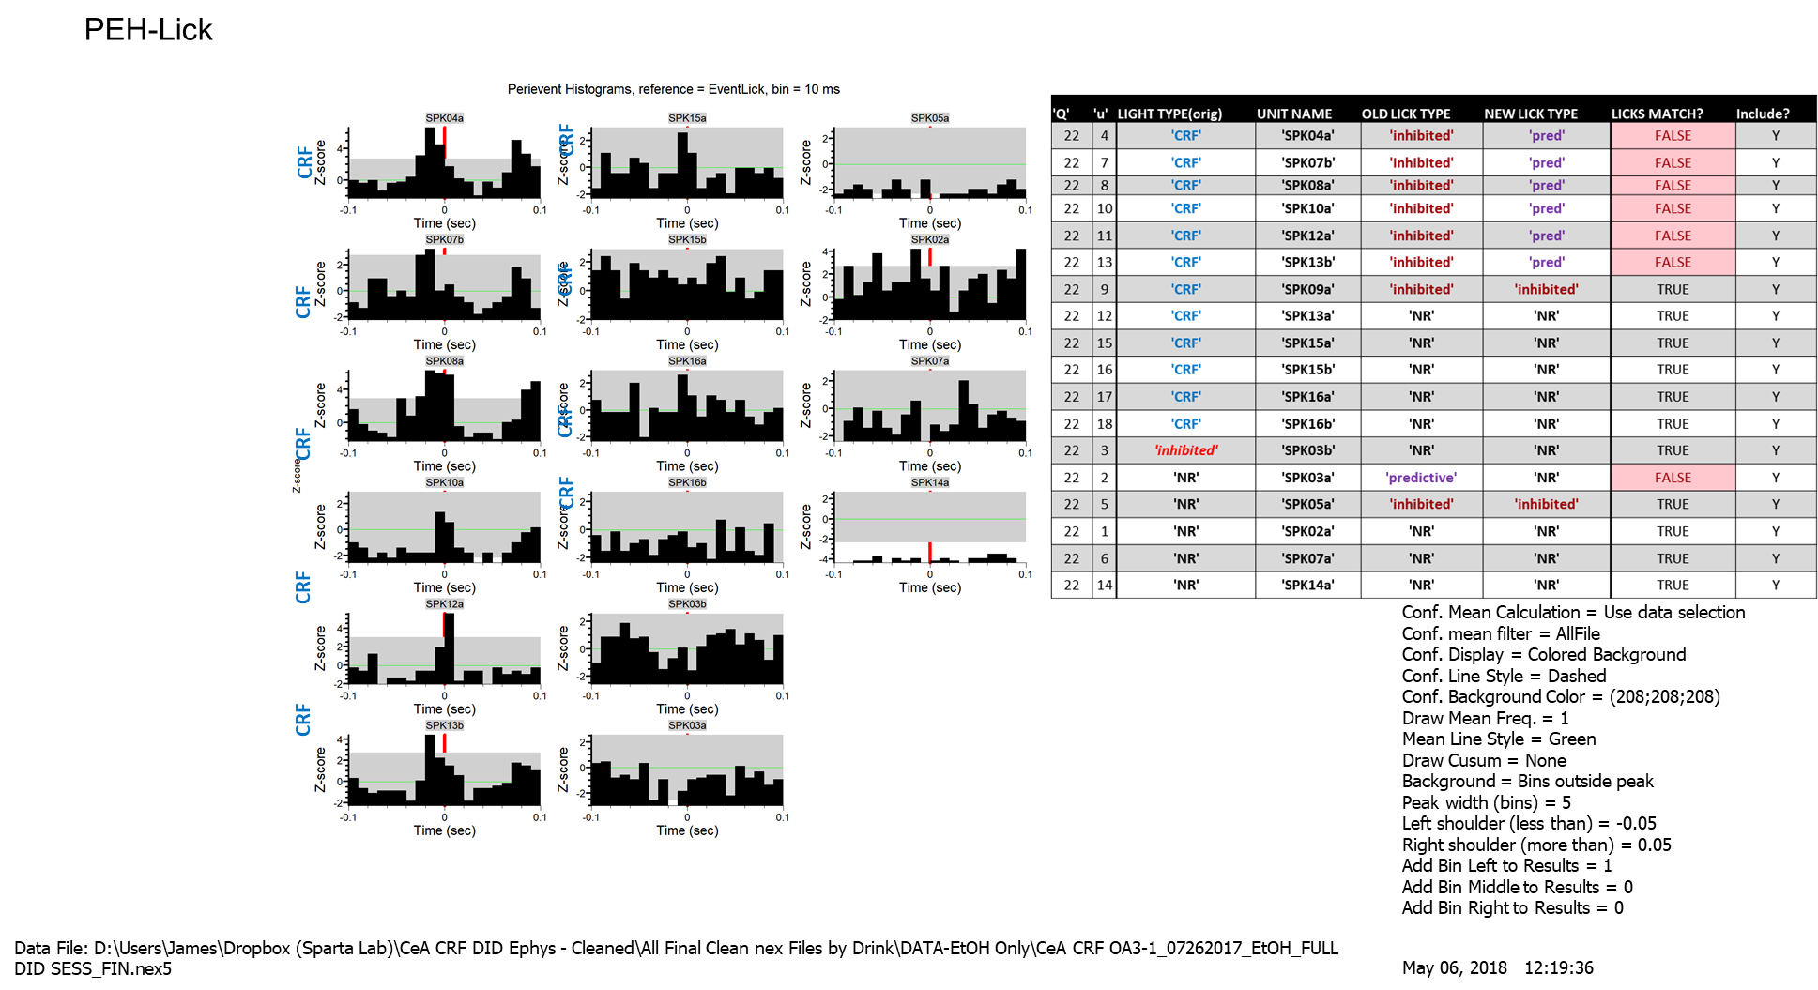
CRF-I that became CRF-P, Pt2

Slide 8
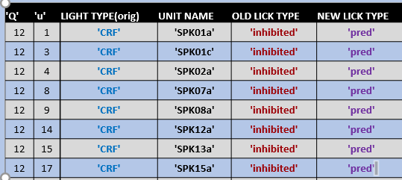
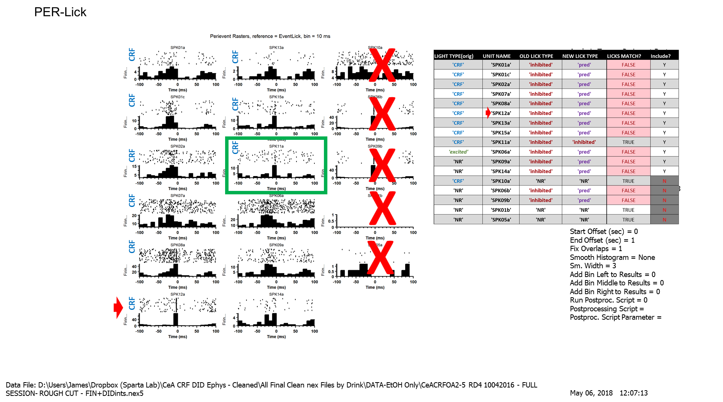
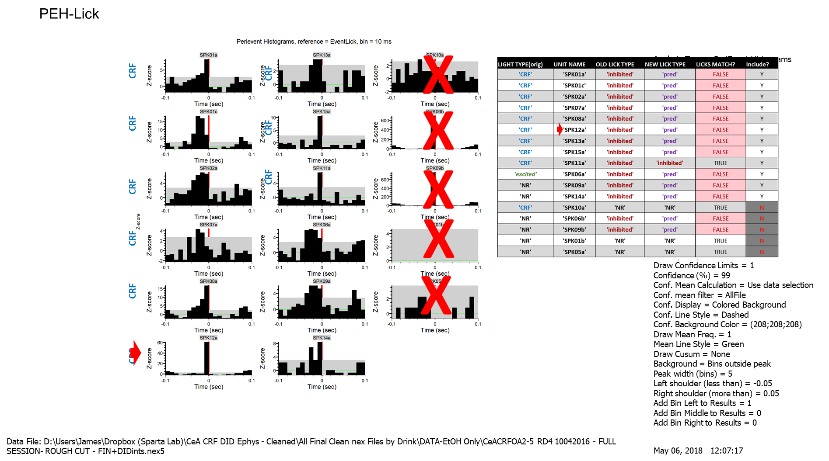
CRF-I that became CRF-P, Pt3

Slide 9
CRF-I units that are still CRF-I:
Do we think they should stay CRF-I??

Slide 10
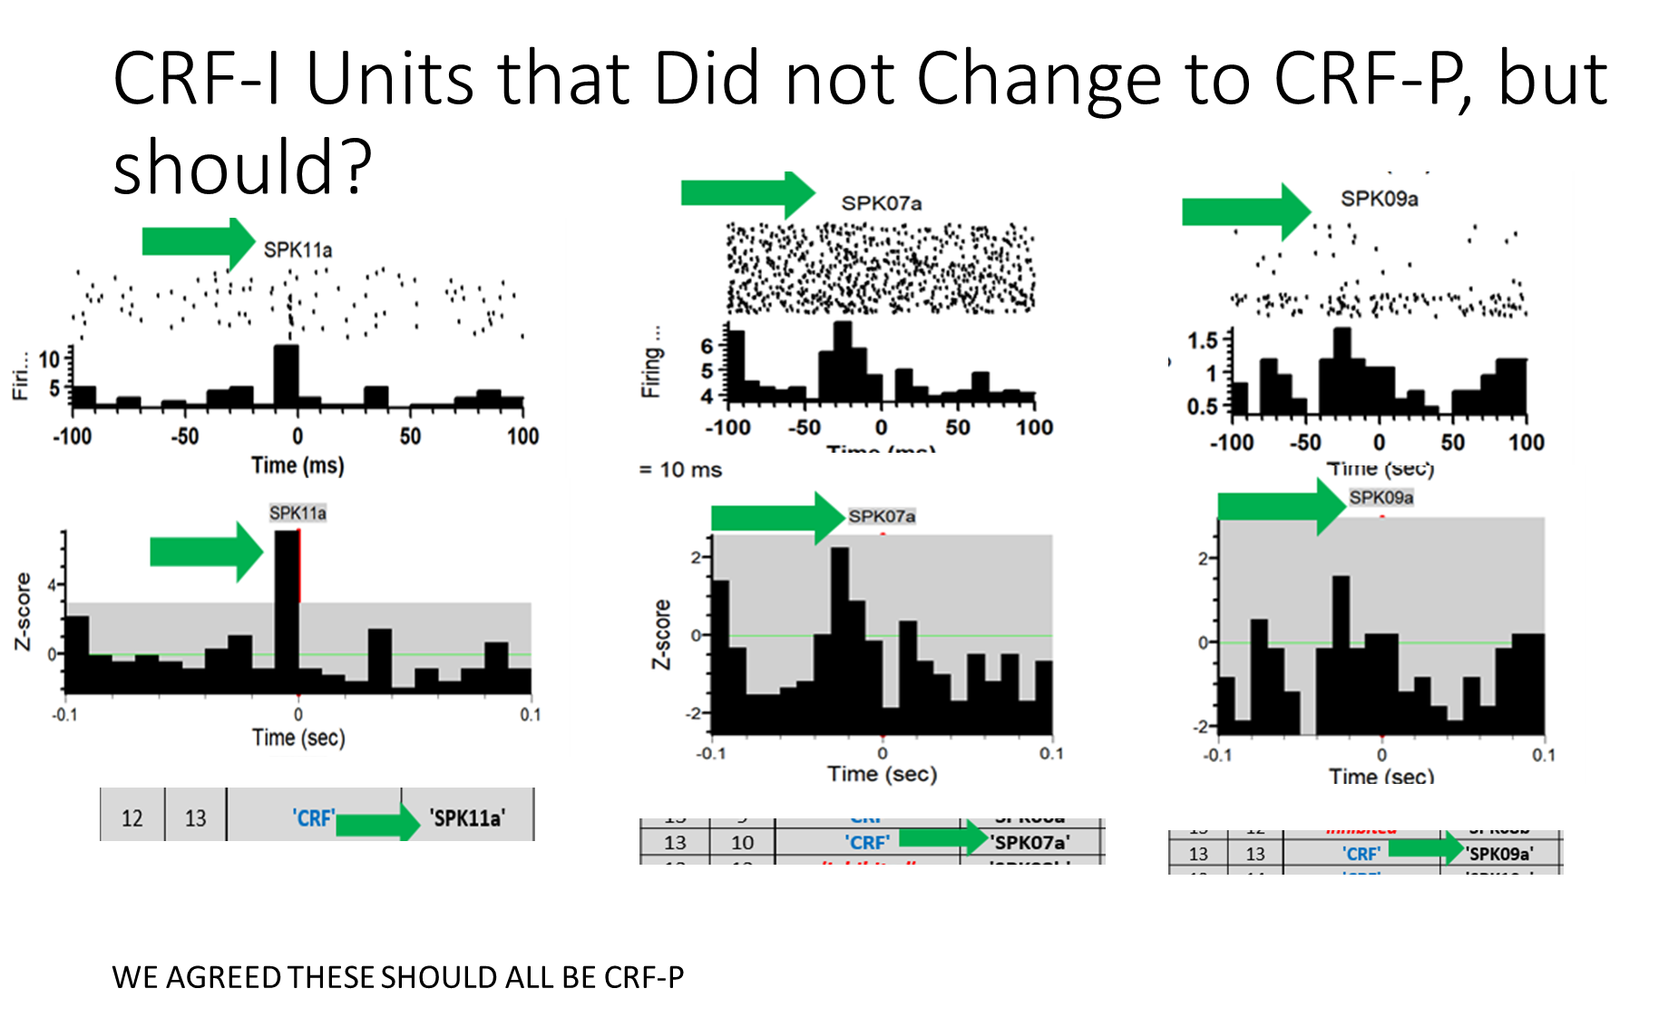
WE AGREED ALL OF THESE SHOULD BE CRF-P

Slide 11
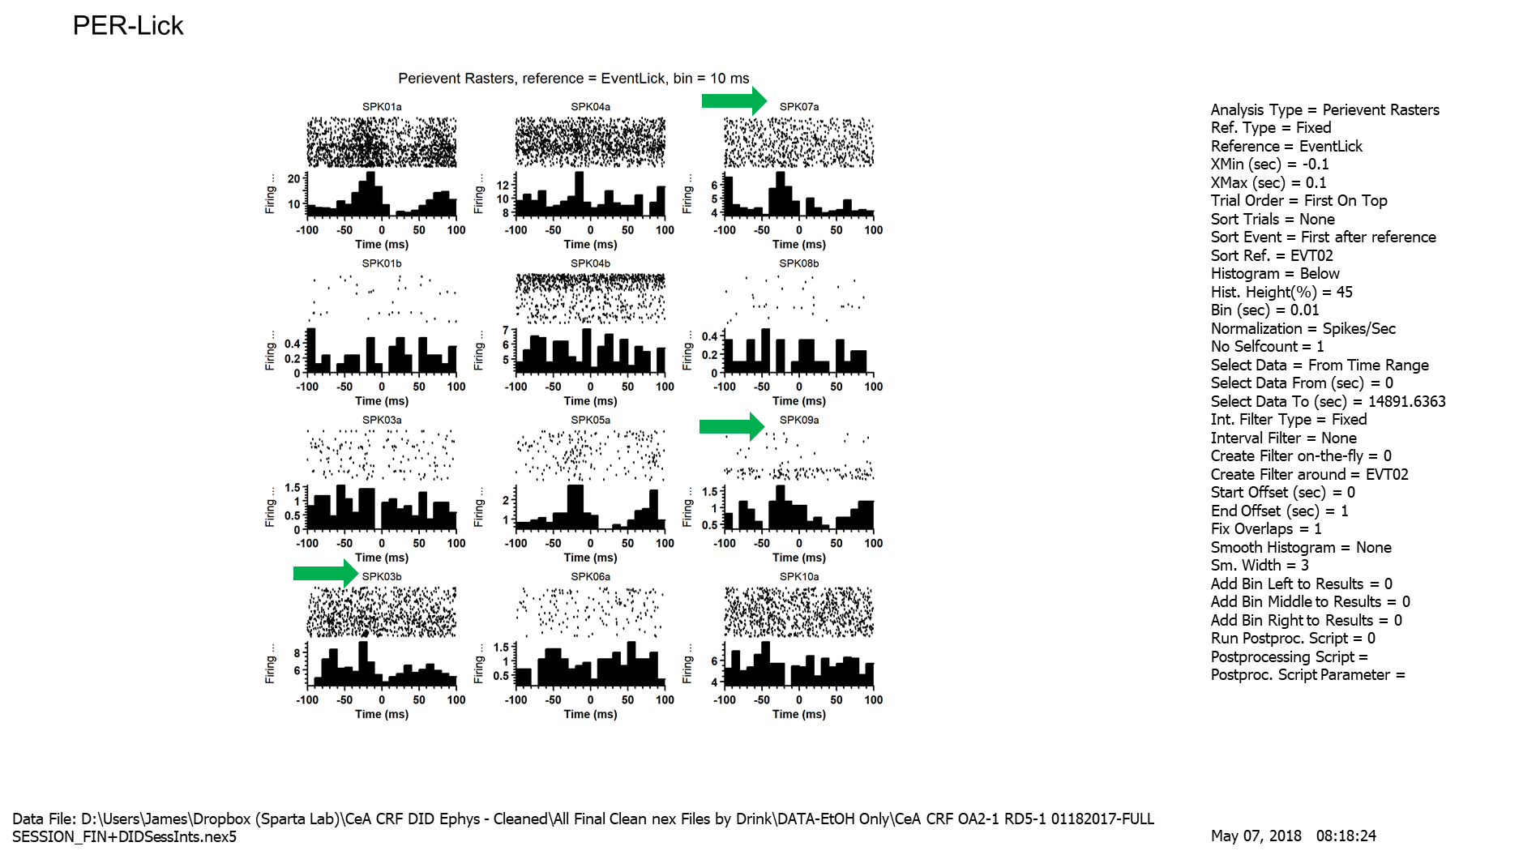
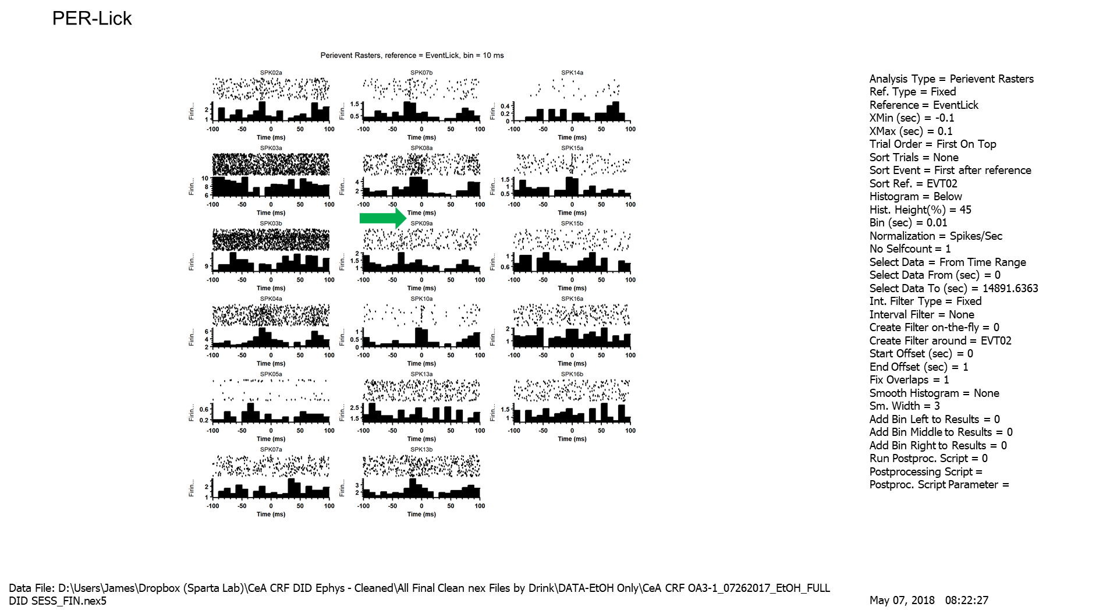
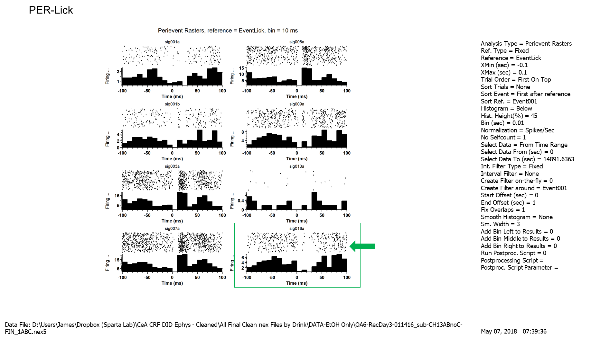
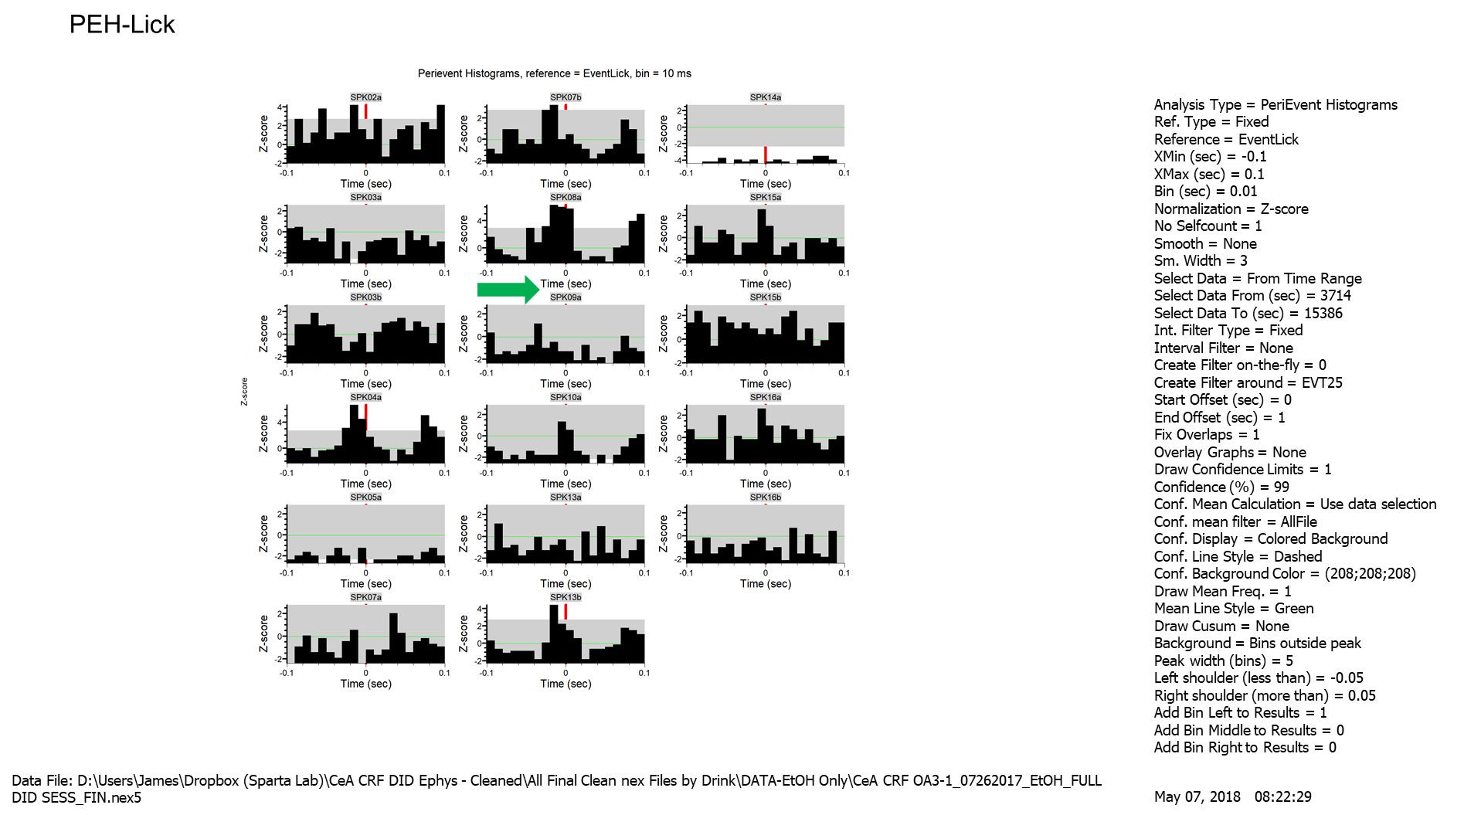
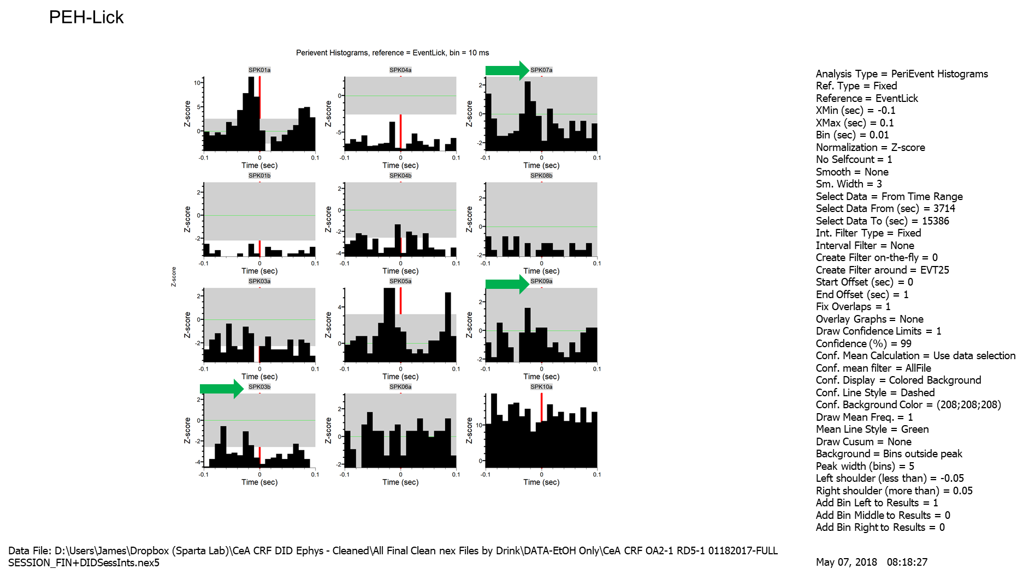
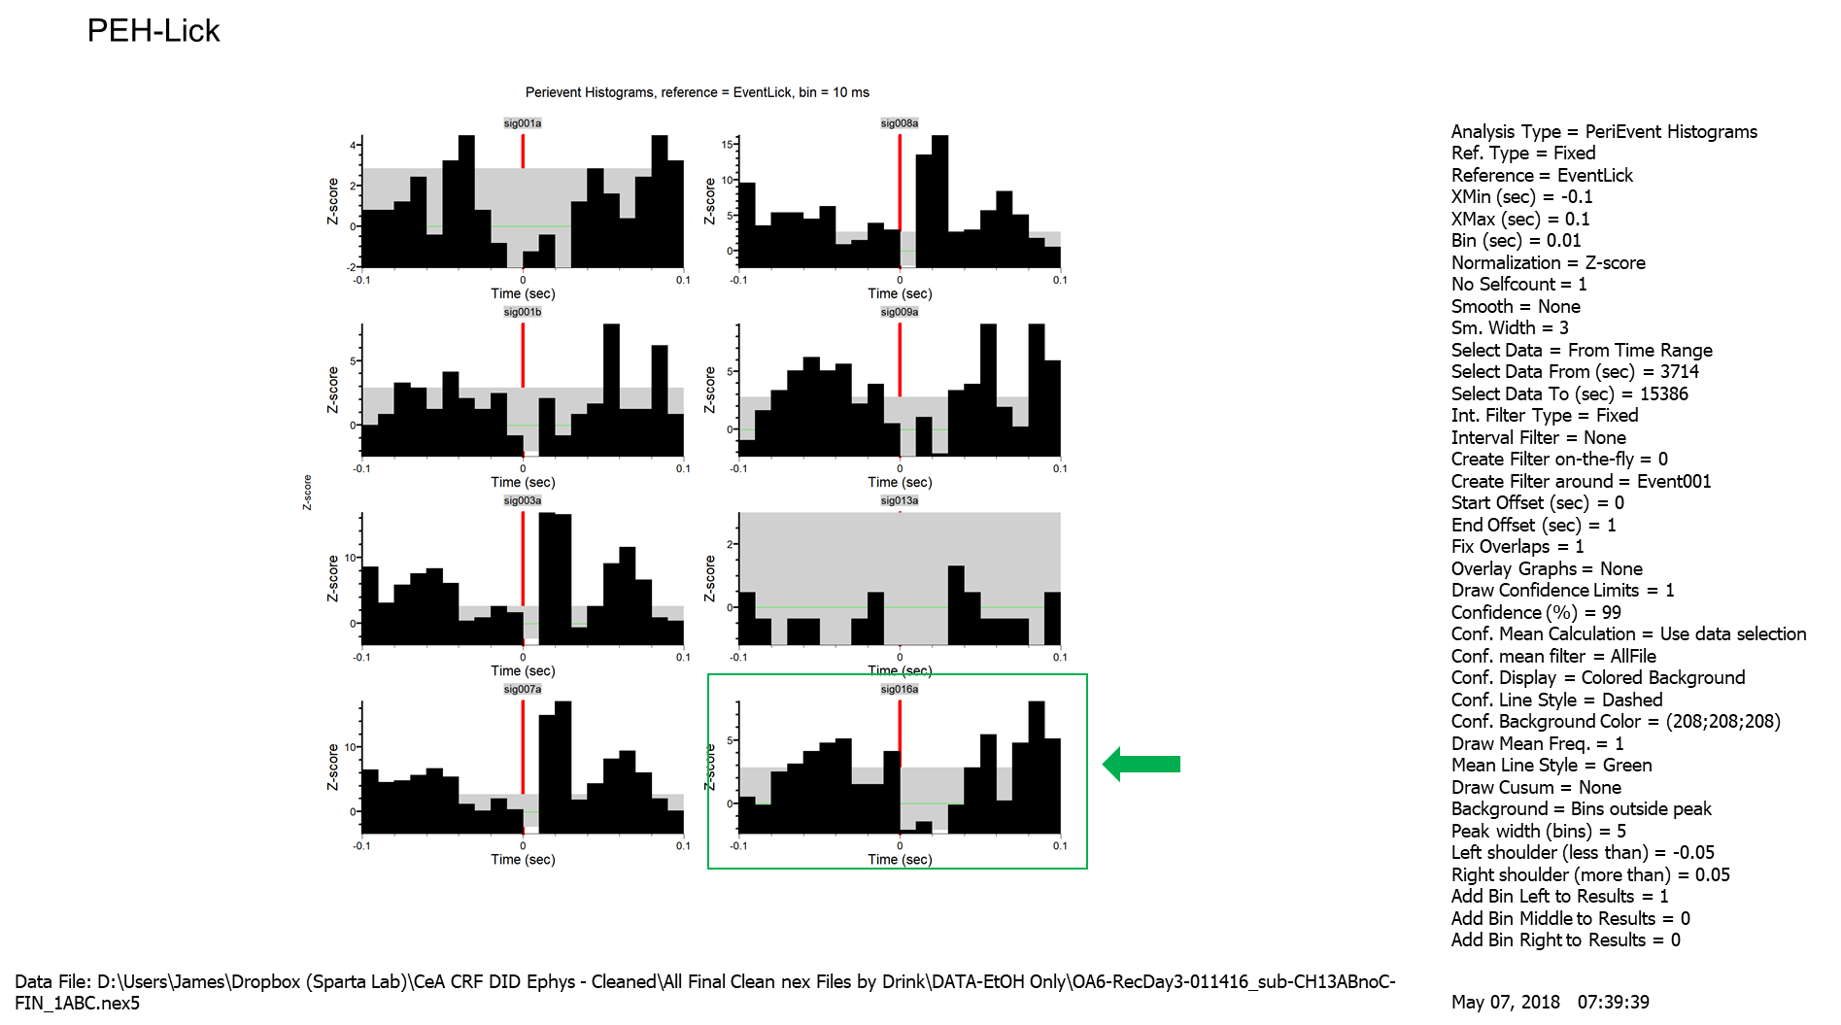
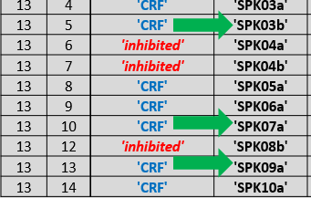
CRF-I Units that could be CRF-P… but don’t work well with our current timebins
CRF-I
CRF-I
WE AGREED 3b, SHOULD BE CRF-P; 9a, 16a should stay CRF-I
our timebins (-100 to -50 ms, -50 to 0ms, 0 to +50 ms)

